Slide 1


Introduction to Test Automation & Tools

Slide 2

What will we cover today?
What is automation?
Why automation – Why do we automate?
What is Selenium?
Why do we use Selenium?
How Selenium works?
Create project and add Selenium
Do some basic navigations using Selenium

Slide 3
What is the goal of today’s class?
After today’s class you should be able to:
Understand how Selenium Works
Create projects with Selenium
Open a browser using Java & Selenium
Do some basic navigations with selenium

Slide 4
What is automation? (by definition)
Definition#1: The use of machines and technology to make processes run on their own without manpower.
Definition #2: Automation is the technology by which a process or procedure is performed with minimal human assistance.
Basically if there is a simple process that is just repeating itself, and you take out human interruption, you automate it.

Slide 5
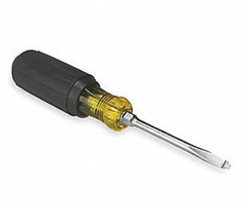

Any examples you can think of?

Slide 6
AUTOMATION

Slide 7
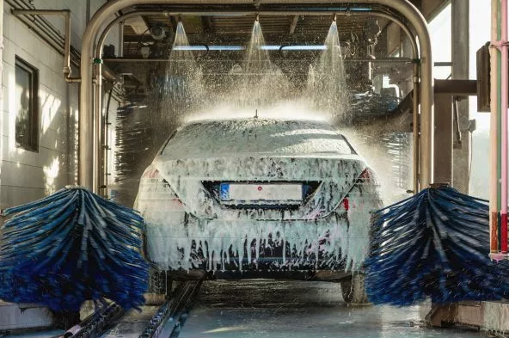
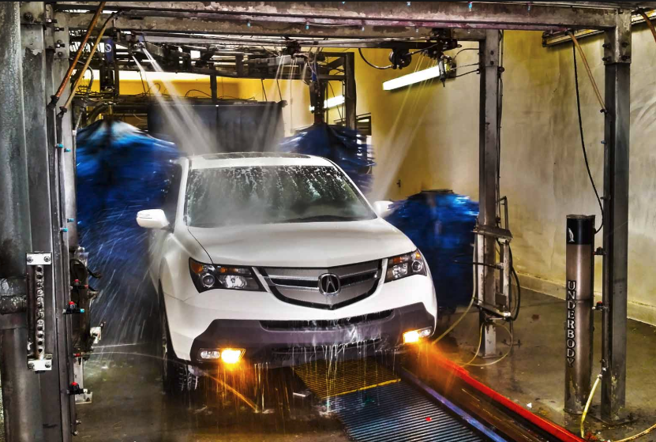
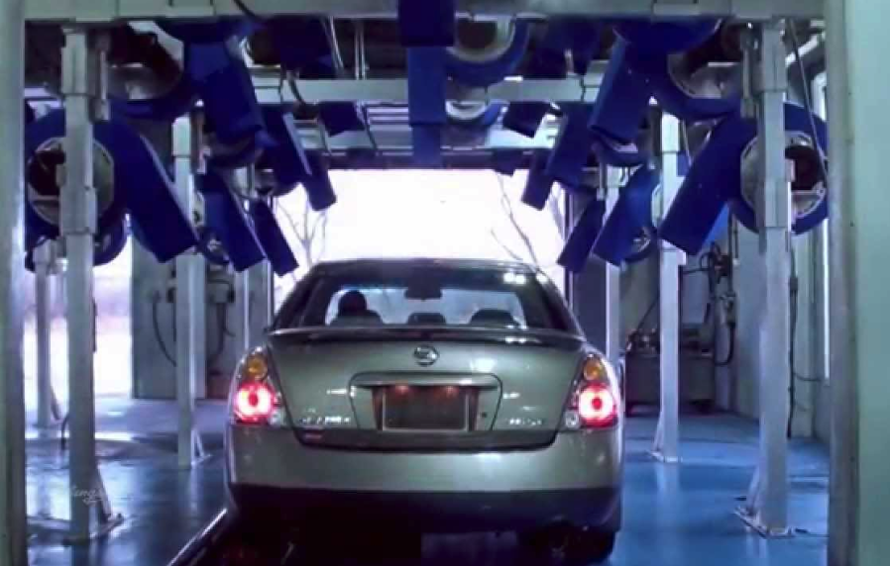
Simple example:
Carwash:
Pay
Get receipt
Drive on rails
Shampoo
Brushing
Rinse
Dry

Slide 8
Automation requires the use of machines/tools to carry out manufacturing processes with levels of;
speed,
consistency,
stamina (durability),
and precision beyond the capacity of a human worker.

Slide 9

Most of the things that we are using on a WebApp is automated.
When you login to Facebook…
There isn’t someone that is checking your username and password manually.

Slide 10

Why Test Automation

Slide 11

Walking vs Driving
‹#›
Walking can take hours/days.
While Driving will only take minutes/hours.
Not efficient.
Fast.
Doable maybe once in the while.
Doable all the time.

Slide 12


Manual vs Automation
Manual Testing is time consuming.
Automation can do probably 100 times more.
Ex: In our current project manual testers can execute 4 test cases a day per recourse in average.
If the test cases are automated we can execute 100 test cases a day per machine.

Slide 13

Manual vs Automation
‹#›
Manual testing is repetitive effort.
Once the test cases are automated we can run the same code as much as we need.
Every time testers have to repeat the same time and effort to execute the same test cases.
Automation is one time effort. Only minor maintenance is needed.

Slide 14
Manual vs Automation
‹#›
Manual needs more human resources.
Automation needs more machines.
Accenture had more than 70 manual testers for healthcare.gov project.
They were 8 automation testers and 60 virtual machines for the same project.

Slide 15
Manual vs Automation
‹#›
Manual testing can be not accurate.
Since manual testers have to repeat the same task again and again in the same project it can become boring and testers might miss the defect.
Automation is highly accurate. Even close to 100%.
It can catch the difference between AutOmation and Automation.

Slide 16
Manual vs Automation
‹#›
In most cases production deployment will be performed at midnight. Manual testing can be run only when testers are present.
Automated tests can run anytime without human intervention. It can be run day and night. You can kick off your tests at midnight and entire team can get the test run report at 7 AM in the morning.

Slide 17
Manual vs Automation
Test data creation can take a lot of time and effort.
Test data creation can be automated.
In some cases the testers might spend 15 minutes to create one test data and they can only use it one time.
Test data can be created very efficiently using automation. It can save the company a lot of time and the money.

Slide 18
Manual vs Automation
‹#›
Manual testing will not go away. It is necessity.
100% automation is not possible.
Normally it is recommended to automate after the functional or manual testing is done. You can’t automate broken software.
Some test scenarios cannot be automated.

Slide 19



Manual vs Automation
‹#›
It is almost not possible to perform performance testing manually. No company can hire 10000 people to perform load testing.
Performance testing can be done by creating many virtual users.

Slide 20
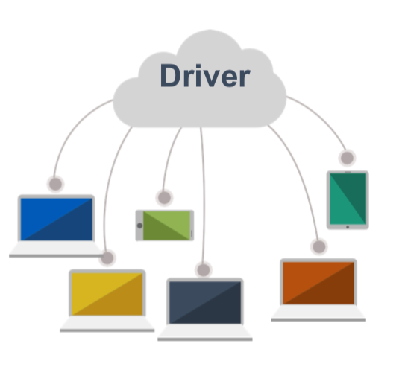
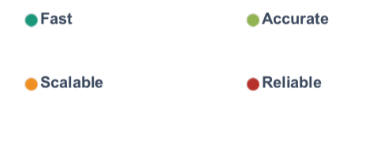
Parallel Execution
You are able to create different virtual machines and run parallel executions to shorten the testing duration.

Slide 21
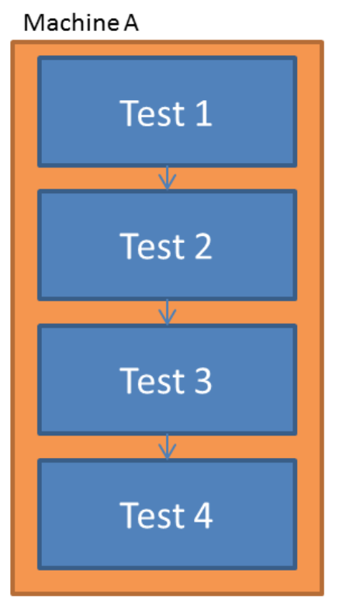
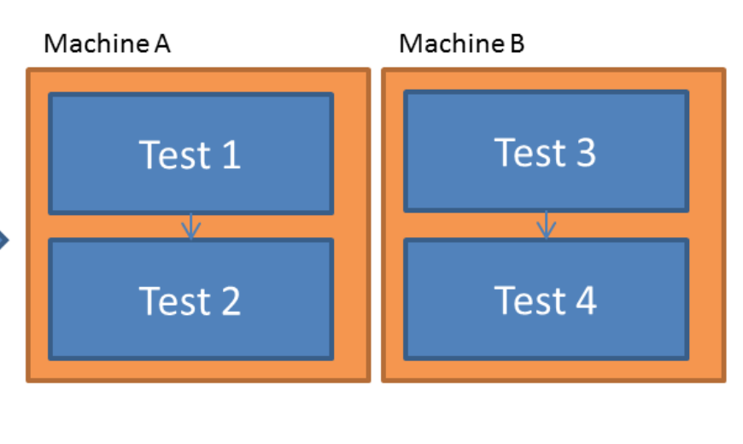

Parallel testing

Slide 22
Automation process
Test tool selection
Test tool selection largely depends on the technology the Application Under Test is built on.
Application Under Test (AUT): The application you are working on to test.
Define the scope of automation.
Scope of automation is the area of your application (AUT), which will be automated.
Planning, design, and development.
During this phase, you create automation strategy & plan.
What type of tool should be used,
What kind of framework should be used
To what extend we are planning to automate

Slide 23
4. Test Execution
Automation scripts are executed during this phase.
5. Maintenance
As new functionalities are added to the Application, automation scripts needs to be added, reviewed, and maintained for each release cycle.
Maintenance becomes necessary to improve effectiveness of Automation Scripts.

Slide 24
Automation Tools
UFT : Formerly known as QTP. It was the market leader. Costly.
Rational Robot : It is an IBM tool used to automate tests. Costly.
Worksoft…
TestComplete…
Protractor…
Watir…
Selenium : It is an open source WebApp Automation Tool.

Slide 25
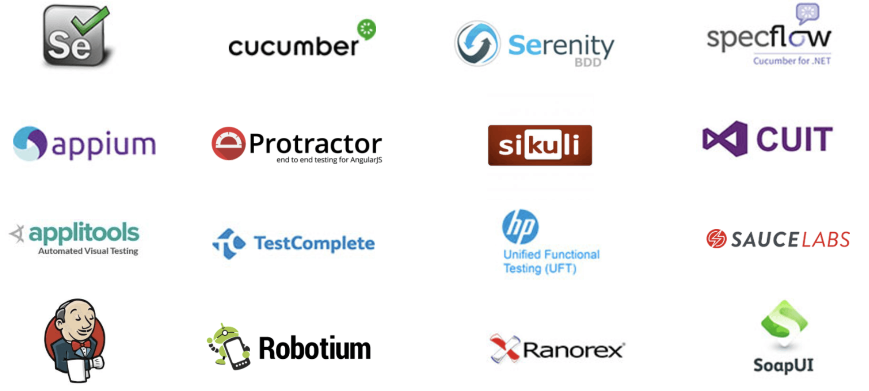

Slide 26
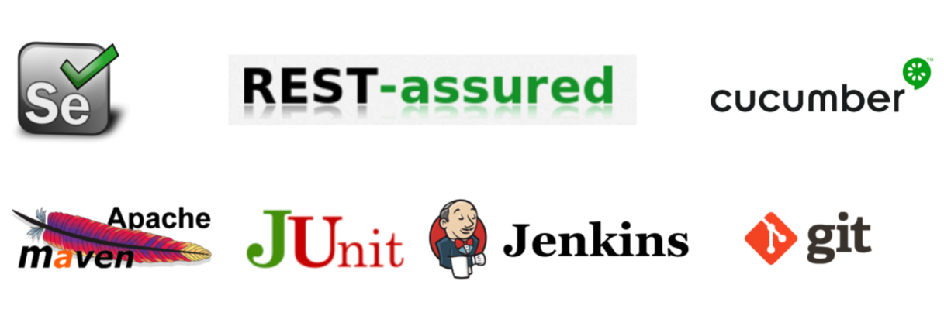

We will learn more than Selenium!

Slide 27
How to choose an automation tool
Tool selection is one of the biggest challenges to be tackled before going for automation
First identify the requirements, explore various tools and its capabilities
Set the expectation from the tool and go for proof of concept
Proof of concept: Basically you create a pilot to test if it is working well or not.

Slide 28
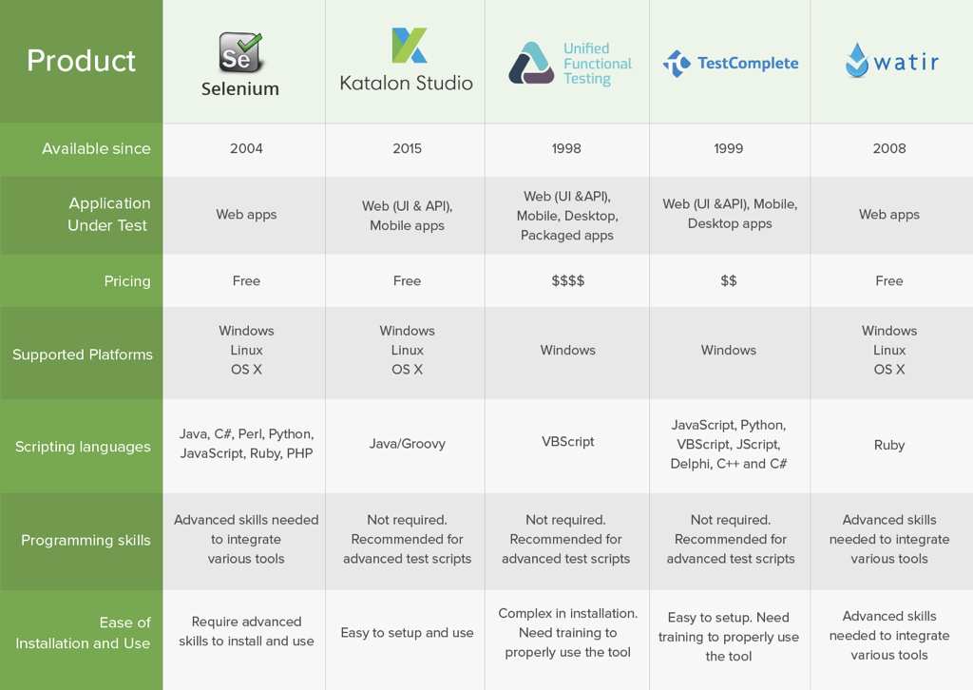
SELENIUM

Slide 29
What is Selenium?
A tool that automates browser
Lets us control browser using code
Mostly used for testing
It is actually just a library (classes and methods)

Slide 30
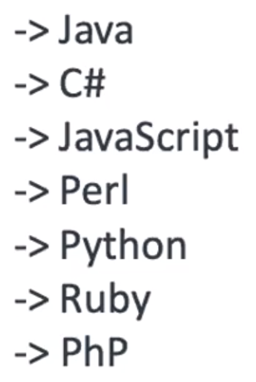
More about Selenium…
Selenium is an open source automation testing tool
It is used exclusively for web based applications
You can work on multiple operating systems using Selenium
Platforms supported by selenium
Windows
OS X
Linux
Languages are used with selenium
Java
C#
Ruby
Python
Browsers are supported by selenium
Internet Explorer
Firefox
Chrome
Safari

Slide 31
Where did Selenium come from?
Selenium.dev
Selenium RC was created in 2004
Two projects merged in 2009 and Selenium WebDriver was created in 2009.

Slide 32
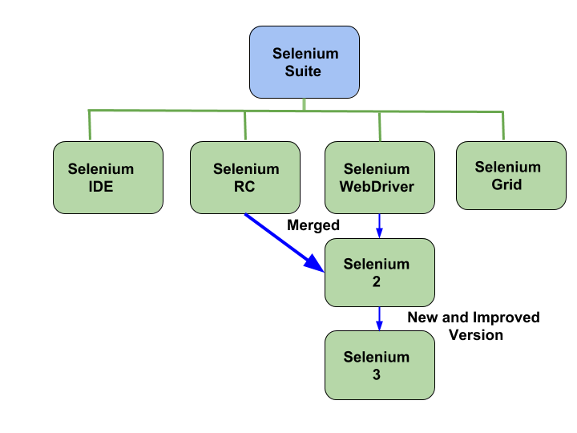
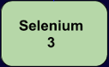
It is just a Firefox plug-in
You add it to your Firefox browser
You record your steps
And re-play
MERGED
RC stands for Remote Control
IMPROVED
2011-2016
2016-2021
Released 2021 December
4

Slide 33
Selenium WebDriver: pros
Free
Multi platform
Multi browser
Multi language
Mobile testing
Scalable and parallel testing
Integration with different tools and frameworks
Community support

Slide 34
Selenium WebDriver: cons
Requires knowledge of a programming language
No built-in reporting
Only works on browsers
No image-based testing
No professional support

Slide 35
Question
My application is developed with C#. Can I use selenium with Java to automate my application?

Slide 36
What can be automated with Selenium?
What is the difference between a WebApp and Desktop app?
WebApp is any website you open in a browser
Desktop app, is any app only your computer from calculator to sublime, to anything else.
Selenium can only automate Web based applications.

Slide 37
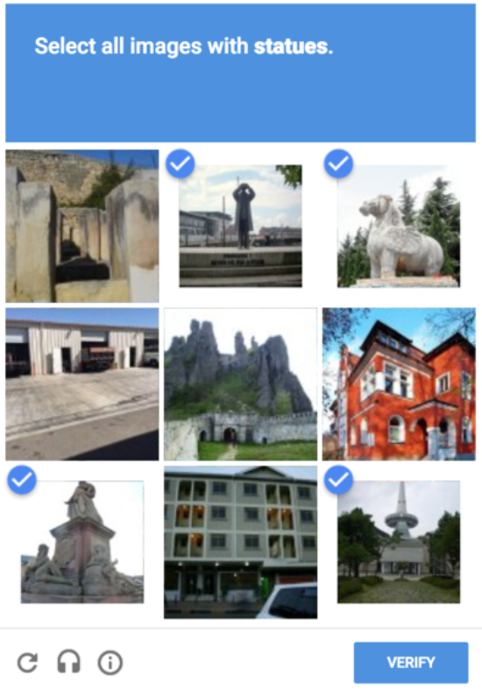
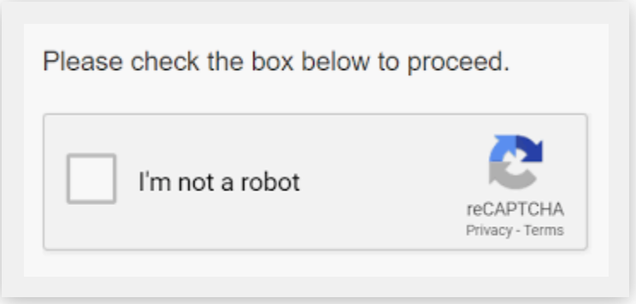
What can’t be automated by Selenium?
Captcha
Completely Automated Public Turing test to tell Computers and Humans Apart .

Slide 38

How Selenium WebDriver Works?
Let’s think taxi driving
We have 3 actors
the client; he tells the taxi driver where he wants to go and how to get there
the taxi driver; he executes the client's requests; the taxi driver sends his own requests to the car
the car; the car executes the taxi driver's requests

Slide 39
How Selenium WebDriver Works?
Test automation engineer is like a taxi client
The browser driver is like a taxi driver
The browser is like a taxi

Slide 40
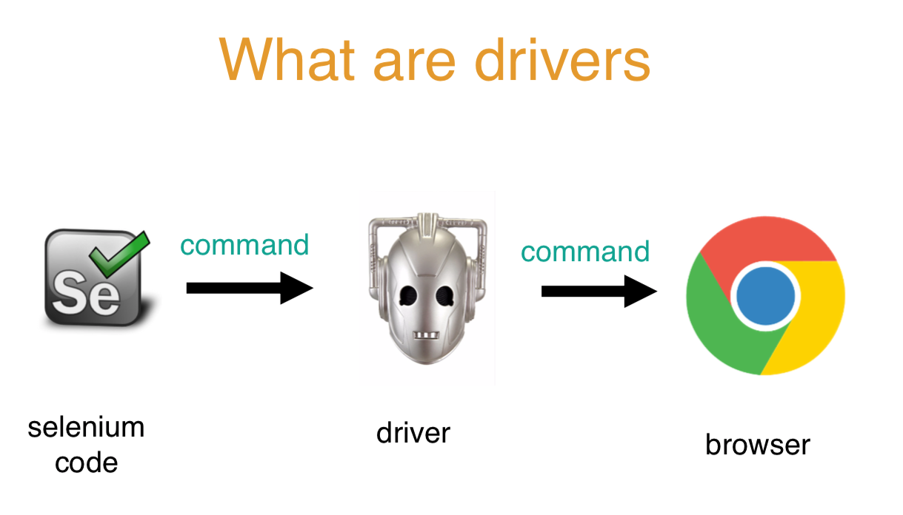
What happens in reality?

Slide 41
How Selenium WebDriver Works?
When the automation script is executed, the following steps happen:
for each Selenium command, a HTTP request is created and sent to the browser driver
the browser driver uses a HTTP server for getting the HTTP requests
the HTTP server determines the steps needed for implementing the Selenium command
the implementation steps are executed on the browser
the execution status is sent back to the HTTP server
the HTTP server sends the status back to the automation script

Slide 42
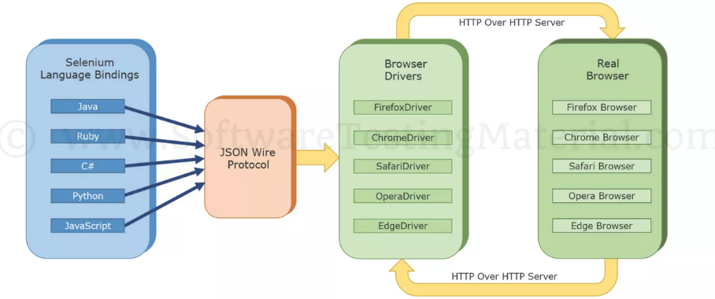
How Selenium WebDriver Works?
WebDriver is a web automation framework that allows you to execute your tests against different browsers

Slide 43
Selenium Architecture
4 components of Selenium Architecture
Selenium Client Library (Language Bindings) (Taxi Driver speaks only Chinese?, Italian?, we need to speak proper language)
Browser Drivers (Different vehicles, different drivers like a truck, airplane, bulldozer etc.
Browsers
JSON Wire Protocol over HTTP

Slide 44
What do I need to able to run selenium program?
JAVA installed
IDE installed
Eclipse
Netbeans
IntelliJ IDEA
Selenium jars or dependencies downloaded
Configure selenium jars in project build path
Create driver object based on browser chosen
Set system property of the browser (not required in maven project using WebDriverManager)

Slide 45
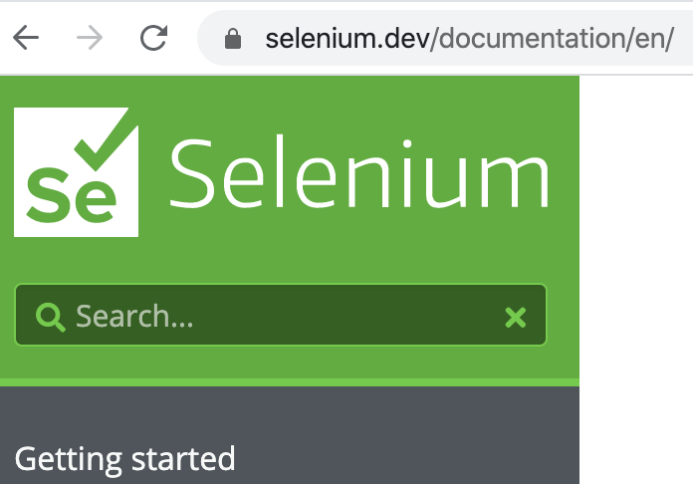
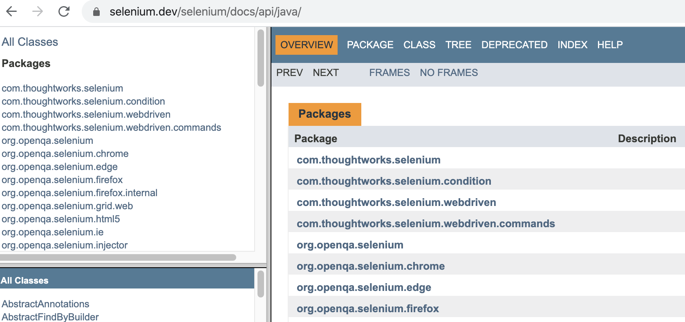
Documentation of Selenium

Slide 46
Let’s create our first Selenium project!
If you already created from the video and everything is working, please do not re-create!

Slide 47
.get(“url”);
* get("url")--> this method launches the browser and goes to the given url.

Slide 48
SELENIUM NAVIGATIONS
back -> takes to previous page
forward -> takes us to forwarded page
refresh -> refreshes the page
to -> takes user to another given url.
Syntax: driver.navigate().back();
driver.navigate().forward;
driver.navigate().refresh();
driver.navigate().to();

Slide 49
.getTitle();
Gets the title and returns it in a String
Good for confirming that you are on the intended page or not.
Syntax: driver.getTitle();

Slide 50
Thread: line of execution. One java program is running on one Thread.
Thread.sleep(2000); -> pauses the program execution for given milliseconds.

Slide 51
.getCurrentUrl();
Returns string that is current URL on browser.
Good for confirming that you are on the intended page or not.

Slide 52
driver.manage().window().maximize();
maximizes the current window

Slide 53
* driver.close();
closes the current window

